Slide 1


Making ML Easy
University of Petroleum & Energy Studies
Hands-on Introduction to Machine Learning
Akshit Gandotra
GDSC UPES

Slide 2


Our Sponsors

Slide 3
What is Machine Learning
A brief Introduction
Machine Learning algorithms enable the computers to learn from data, and even improve themselves, without being explicitly programmed.
Machine learning (ML) is a category of an algorithm that allows software applications to become more accurate in predicting outcomes without being explicitly programmed. The basic premise of machine learning is to build algorithms that can receive input data and use statistical analysis to predict an output while updating outputs as new data becomes available.

Slide 4
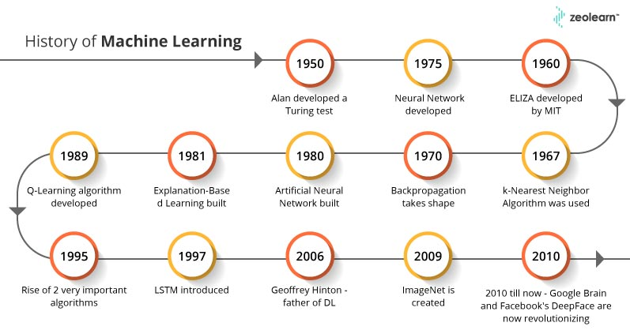
Timeline of ML
Key milestones and advancements in AI/ML

Slide 5
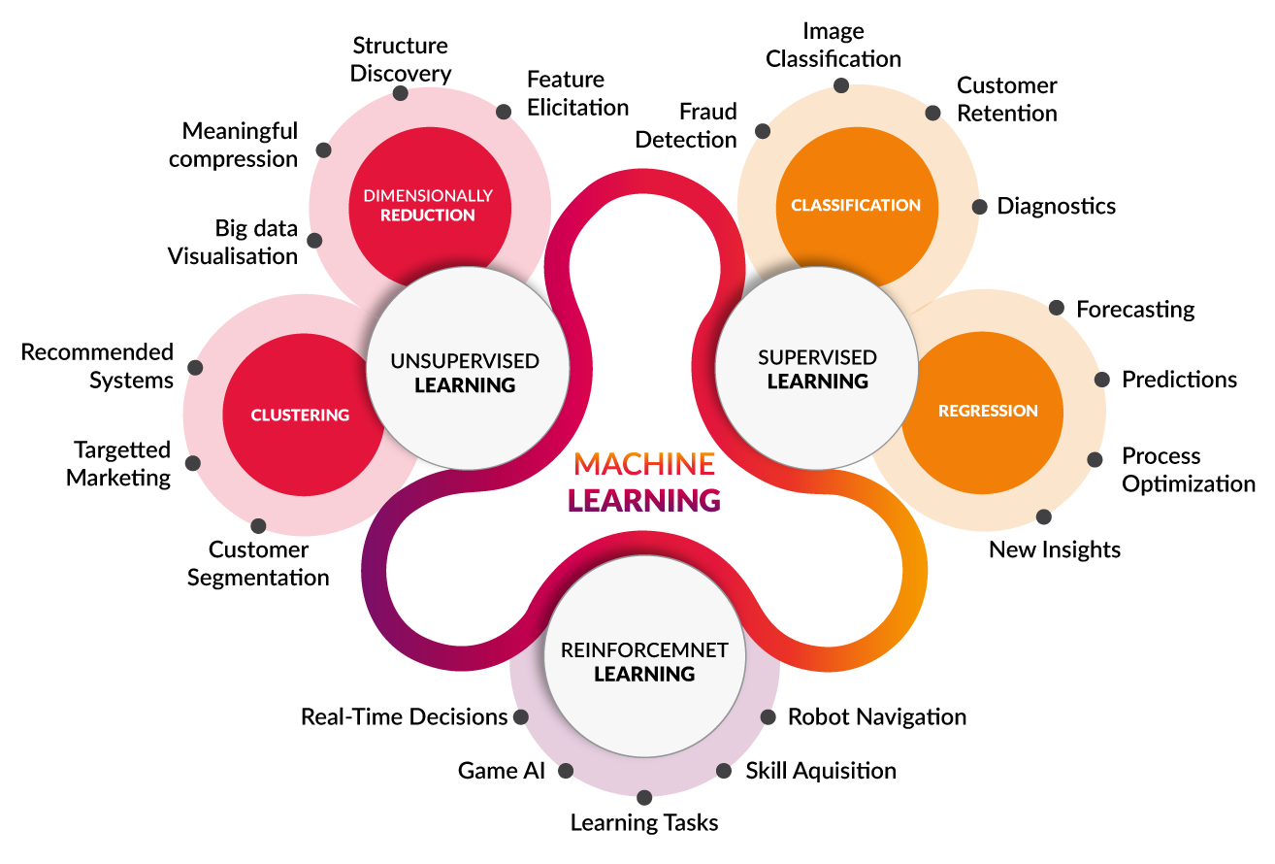
Types of ML

Slide 6
NumPy and Pandas
Pandas is a very popular library for working with data relying on DataFrames. A DataFrame is structured like a table or spreadsheet. The rows and the columns both have indexes, and you can perform operations on rows or columns separately.
NumPy is an open-source Python library that facilitates efficient numerical operations on large quantities of data.
Pandas is built on top of NumPy. So, NumPy is a dependency of Pandas.

Slide 7
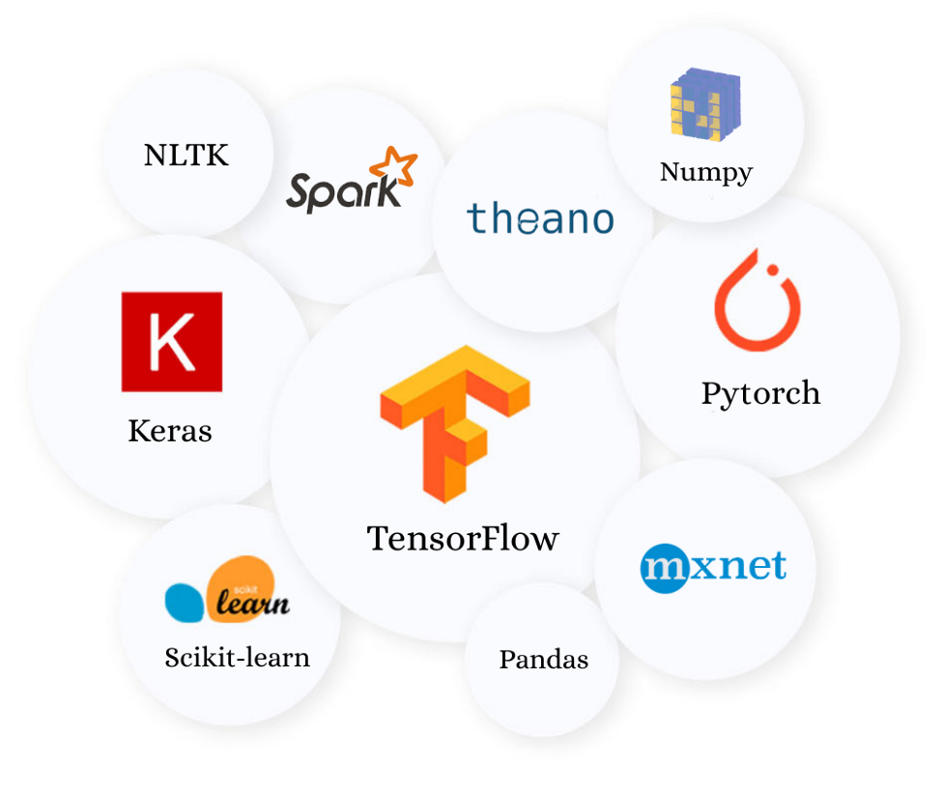

ML Libraries & Kaggle
Some popular ML libraries

Slide 8
Data Preprocessing
An integral step in Machine Learning
Preprocessing refers to the transformation of raw features into data that a machine learning algorithm can understand and learn from.
Categorical features must first be transformed into numerical features before being used for model training. The most common technique used to treat categorical variables is known as one hot encoding or dummy encoding.
Multicollinearity is important to consider.
Cardinality refers to the number of unique values in a given column. If, for example, we have a feature with 50 unique values. Performing one hot encoding would result in 50 columns being created.

Slide 9
Data Preprocessing
An integral step in Machine Learning
Dealing with missing values. Either remove the records or perform imputation. Ranging from the very simple option of substituting missing values with the median, mean or most frequent for the feature. To the more complex where machine learning algorithms are used to determine the optimal value for imputation.
Numerical features in a training set can often have very different scales and therefore require feature scaling.
Binning or discretization is a technique used to convert continuous variables into groups or buckets of similar values. This technique is particularly useful when a variable has a large number of infrequently occurring values.

Slide 10
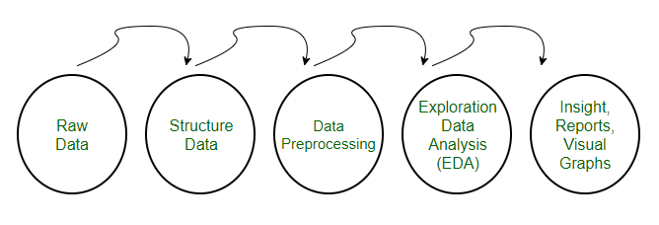
Exploratory Data Analysis
Exploratory Data Analysis refers to the critical process of performing initial investigations on data to discover patterns, to spot anomalies, to test hypothesis and to check assumptions with the help of summary statistics and graphical representations.
It is a good practice to understand the data first and try to gather as many insights as possible from it. EDA is all about making sense of data in hand, before getting them dirty with it.

Slide 11

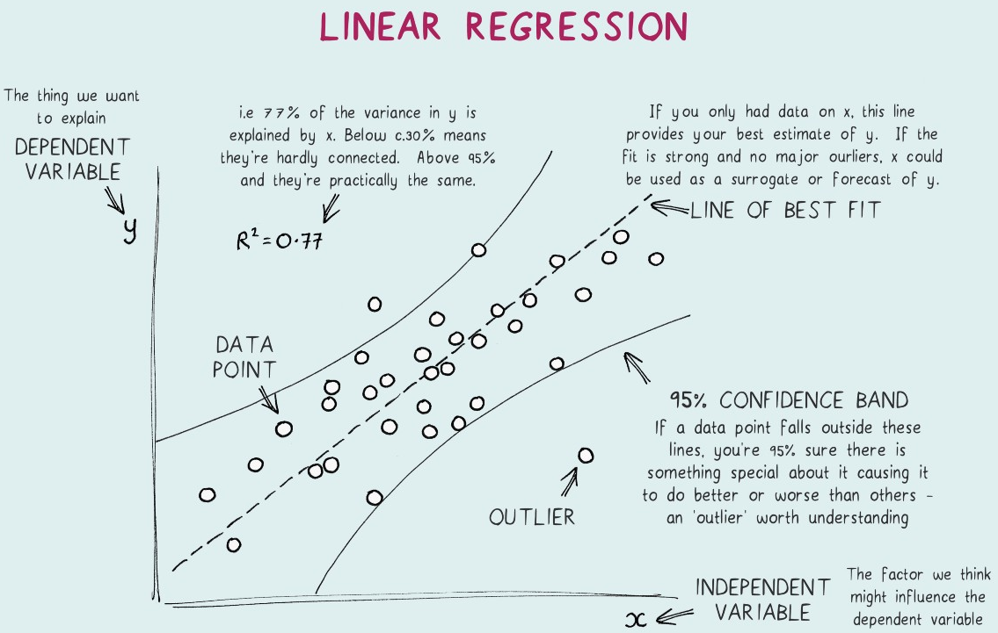
What is Linear Regression?
A linear regression measures the relationship between a response variable Y and a predictor variable X.
The variable you want to predict is called the dependent variable. The variable you are using to predict the other variable's value is called the independent variable.
This form of analysis estimates the coefficients of the linear equation, involving one or more independent variables that best predict the value of the dependent variable.
BEST FIT LINE:
Linear regression fits a straight line that minimizes the discrepancies between predicted and actual output values. Using a “least squares” method we can discover the best-fit line for a set of paired data. We then estimate the value of X (dependent variable) from Y (independent variable).
Courtesy:
Insiya Rizvi
Ananya Mathur
Akshit Gandotra
(Batch 1 AIML Hons.)

Slide 12
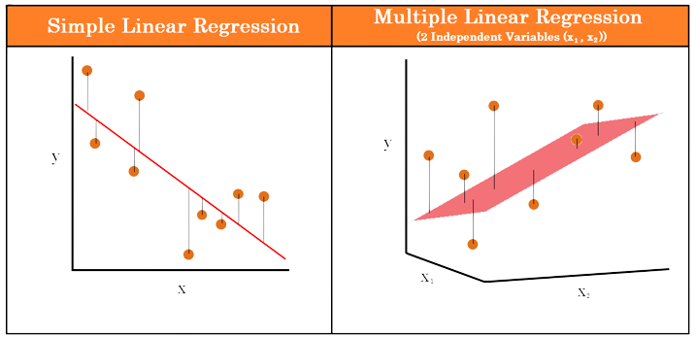
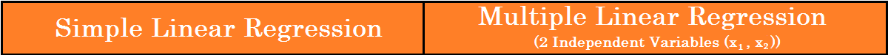
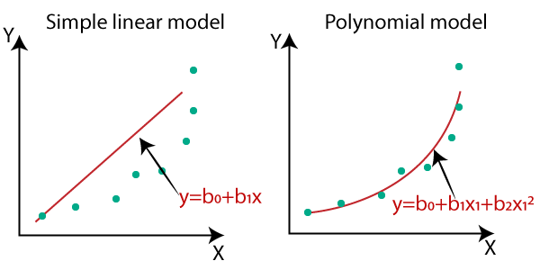
Types of Regressions
The term regression is used to indicate the estimation or prediction of the average value of one variable for a specified value of another variable. There are different types of regression analysis:
1. Linear Regression
It is a type of model where the relationship between an independent variable and a dependent variable is assumed to be linear. There are two kinds of Linear Regression Model:-
Simple Linear Regression: A linear regression model with one independent and one dependent variable.
Multiple Linear Regression: A linear regression model with more than one independent variable and one dependent variable.
2. Polynomial Regression
It is a type of Regression analysis that models the relationship of values of the Dependent variable “x” and Independent variables “y’’ as an nth degree polynomial.
If we apply a linear model on a non- linear dataset, loss function will increase, the error rate will be high, and accuracy will be decreased.

Slide 13
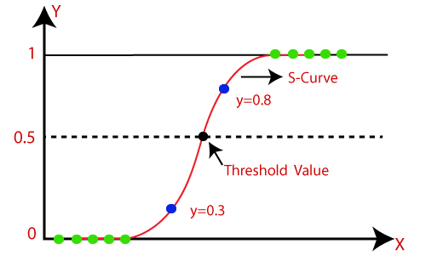
Types of Regressions (Continued)
3. Logistic Regression
Logistic Regression is a method that was used first in the field of Biology in the 20th century. Logistic regression predicts the output of a categorical dependent variable.
For example, the probability of certain events that are mutually exclusive, for example, happy/sad, normal/abnormal, or pass/fail. The value of probability strictly ranges between 0 and 1.
Logistic Regression is much similar to the Linear Regression except that how they are used. Linear Regression is used for solving Regression problems, whereas Logistic regression is used for solving the classification problems.
In Logistic regression, instead of fitting a regression line, we fit an "S" shaped logistic function, which predicts two maximum values (0 or 1).

Slide 14
Hands-on Experimentation with Regression

Slide 15
I would be happy to answer and questions!

Slide 16
THANK YOU!

